Slide 1


A swarm of robots for encouraging desired social behaviors
Serge Saaybi
Thesis Status update report
TU Delft | 27 April 2021

Slide 2
What has been done
A swarm of robots for encouraging desired social behaviors
Fix the ROS/Gazebo environment on ubuntu
Test out navigation without collision using SLAM and using Lidar in ROS and Gazebo
Computer Vision in robotics- Test out image recognition from a camera attached on a robot in ROS/Gazebo
Test out the turtlebot tutorial with DQN:
Travel to a target location
Travel to a target location while avoiding obstacles
Reviewing some literature on Deep Reinforcement Learning
Reviewing literature on navigation in DRL

Slide 3
Navigation without collision using SLAM and using Lidar
Simulating the Lidar:
Robot wander in the environment while avoiding the obstacles
If there is no obstacle, move forward
Else go back and rotate counter-clockwise until avoiding the obstacle.
The robot then goes from one side of the world to the other while avoiding obstacles

Slide 4
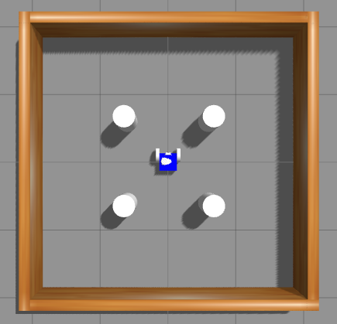
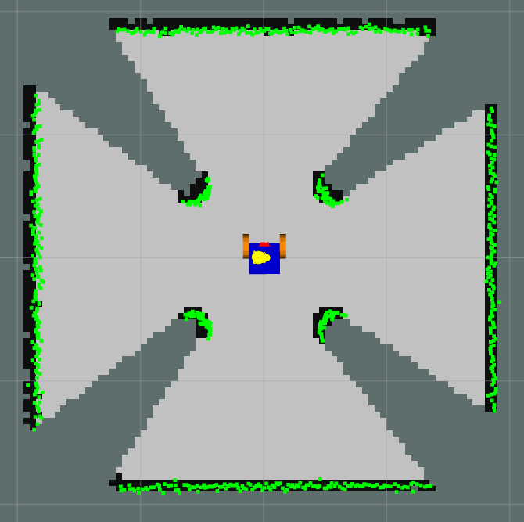
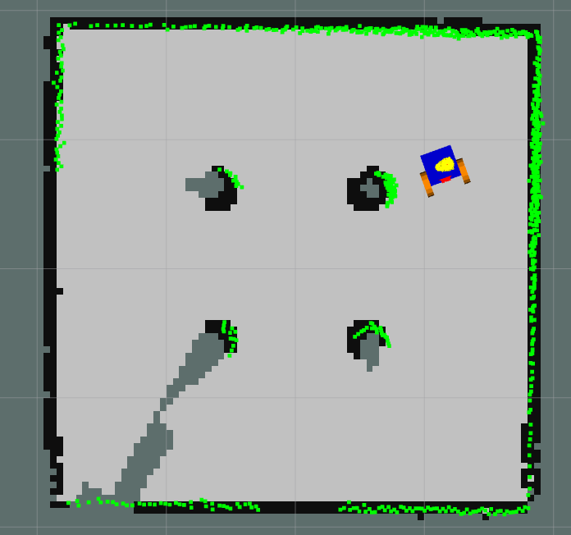
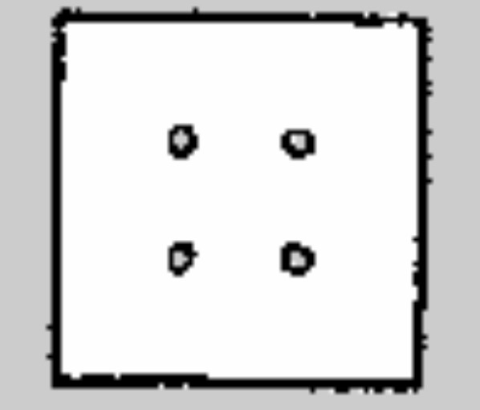
Navigation without collision using SLAM and using Lidar
Robot navigation in ROS can be done using a lidar that provides 360° coverage, allowing the robot to be aware of all the objects and obstacles around it.
The SLAM process:
Launch the robot model within a modeled environment.
Launch the mapping ROS package
Launch a visualization in RViz
Teleoperate the robot to make it cover as much as possible of the surface of the virtual environment.
Once the exploration is finished, save the map
The navigation process:
Launch the robot model within the modeled environment
Provide the map built previously
Set up the navigation algorithm(i.e. Adaptive Monte Carlo Localization (AMCL))
Launch a RViz visualization
Let the robot navigate autonomously to the target location

Slide 5
Image recognition from a camera attached on a robot
A Pi camera is used for image recognition.
How to integrate an ML task with a robotic application
The input of the neural network is supplied via a subscribed topic: image feed from the Pi camera.
The output is delivered using a published topic
A ROS service is similar to a server/client architecture. The client node (drive node) makes a request to the server node (ML node) and this performs some action (image recognition, distance calculation, etc.). Then, the response is sent back to the client. Then, the robot drive node takes that output topic as the data to determine the command to be sent to the motors.

Slide 6
Turtlebot navigation towards a target using DQN
State: The state is characterized by the range and the angle to the goal location identified using the data streaming from the LDS
Action: By executing an action, the robot moves and changes its state – defined by the new set of range values coming from the LDS.
Reward: Greater reward to an action the robot performs that is more effective in achieving the goal.
If the robot achieves the goal, a success reward of 200 is given.
If the robot crashes into an obstacle, a penalty of 150 is given, that is, a negative reward of -150.

Slide 7
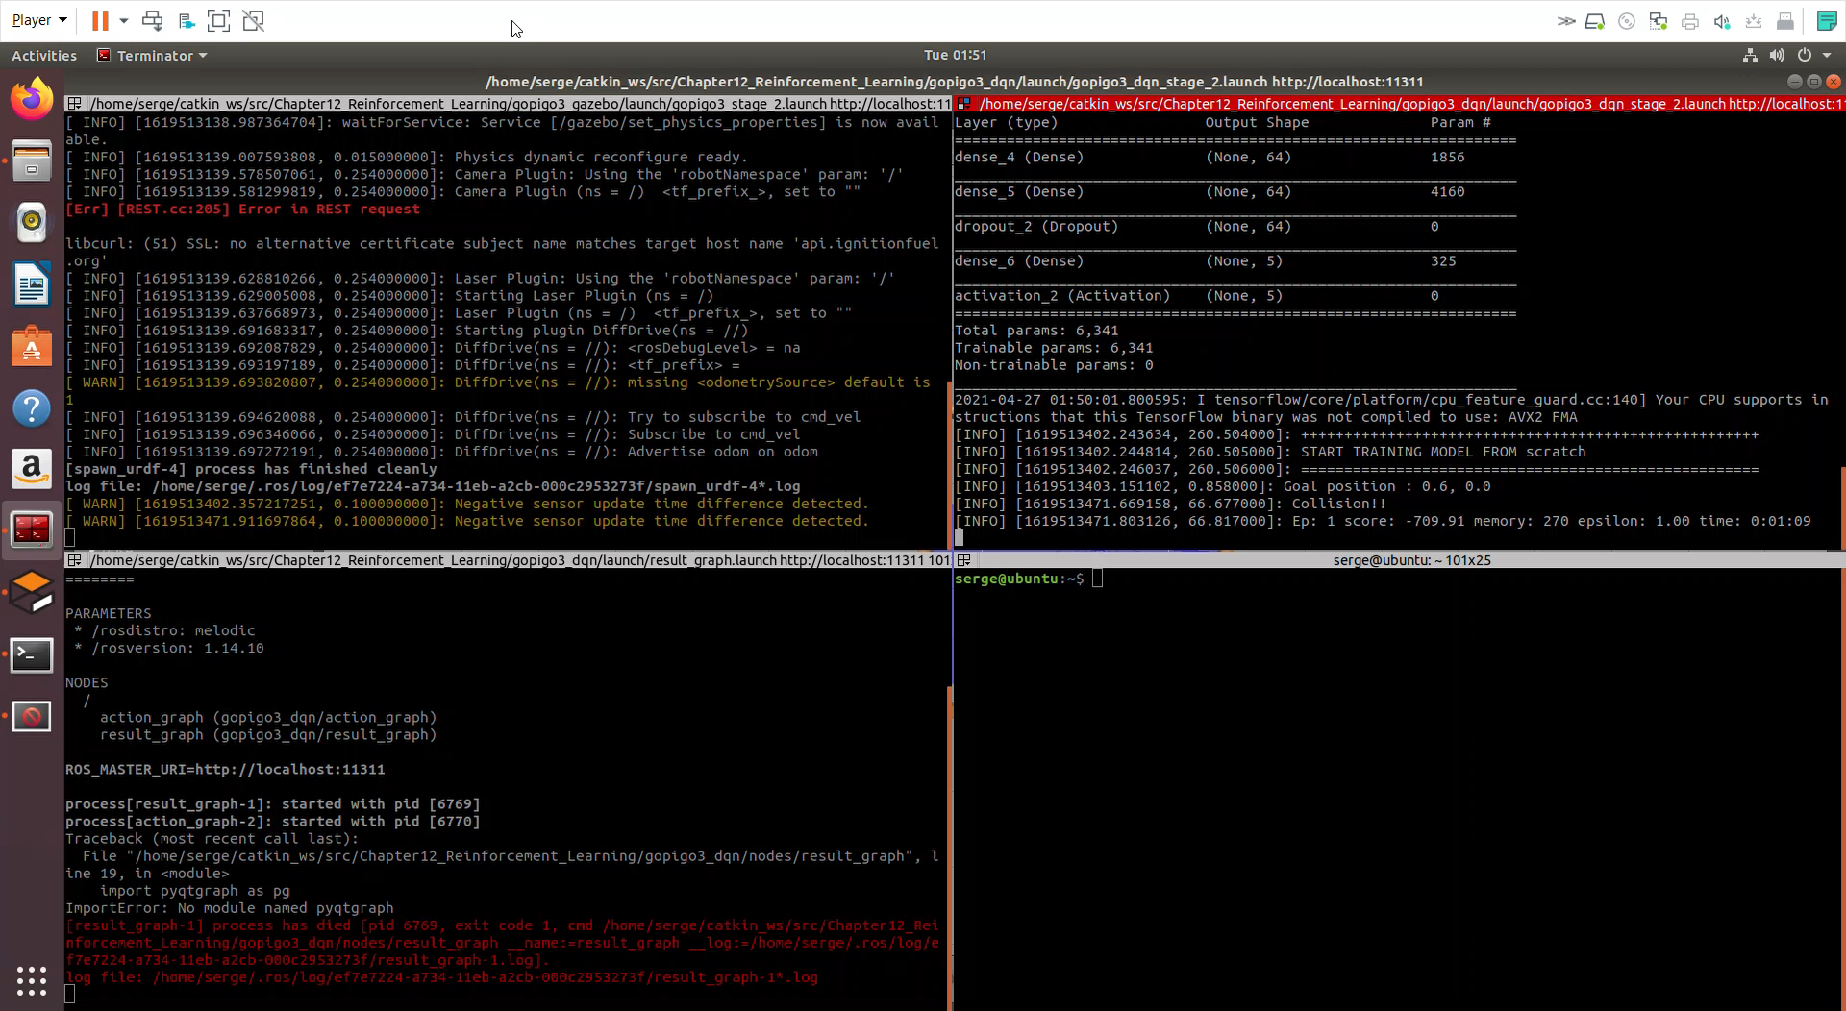
Turtlebot navigation towards a target using DQN with collision avoidance

Slide 8
Next Steps
Identify, compare and assess which DRL navigation algorithm is most suited for our task
A Brief Survey: Deep Reinforcement Learning in Mobile Robot Navigation
A Survey on Visual Navigation for Artificial Agents With Deep Reinforcement Learning
Navigation in Unknown Dynamic Environments Based on Deep Reinforcement Learning
Once an algorithm is identified, work on implementing it

